Slide 1
Waterway-sunrise-i_655C

Slide 2
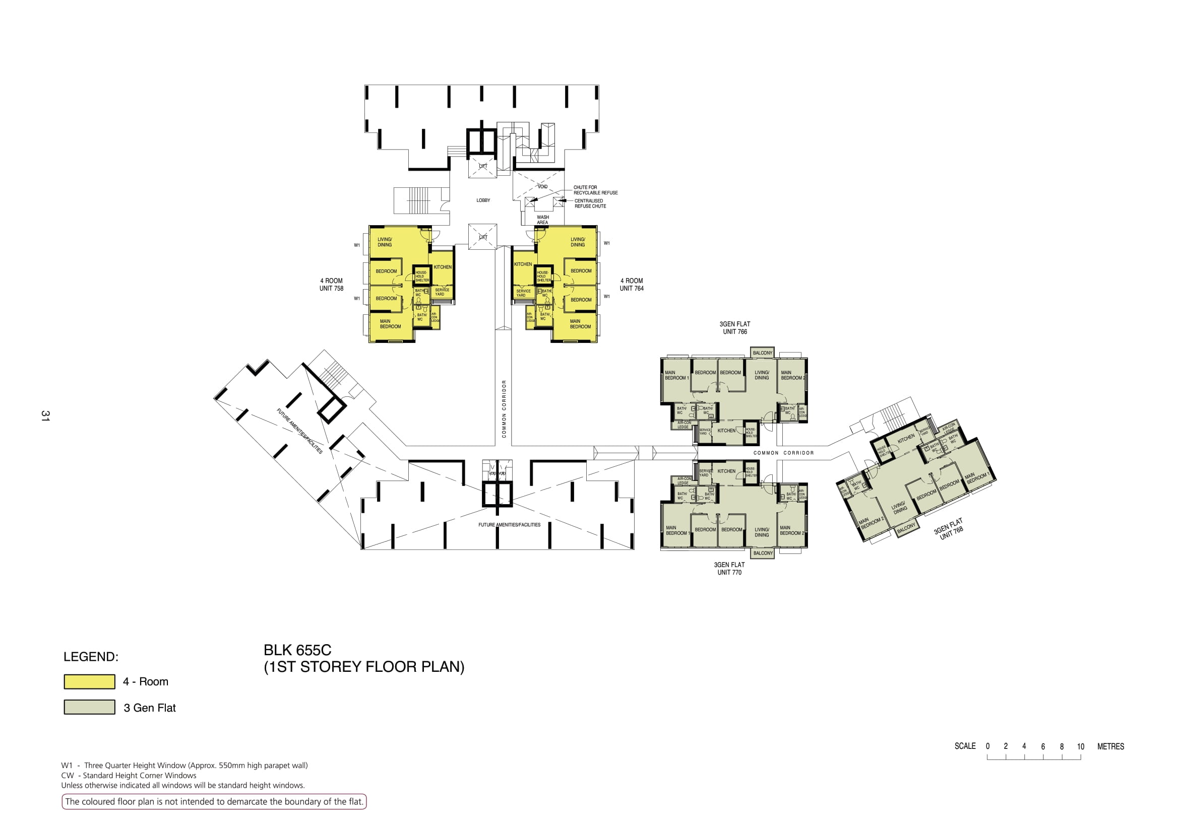

Slide 3
LOBBY
WASH AREA
758
764
COMMON CORRIDOR
766
COMMON CORRIDOR
768
770

Slide 4
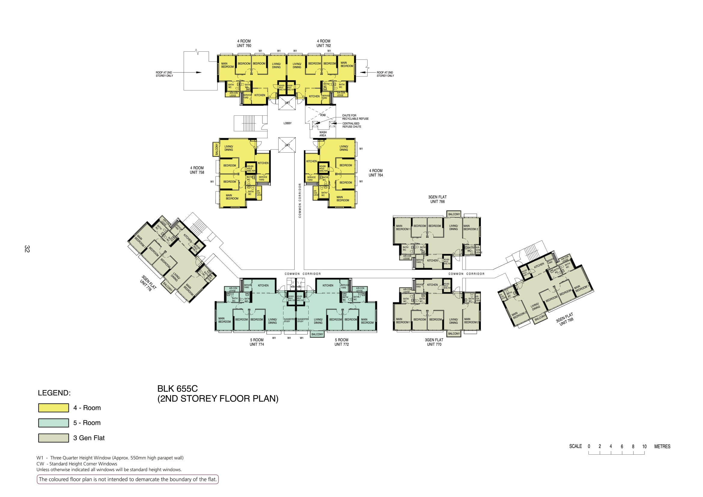

Slide 5
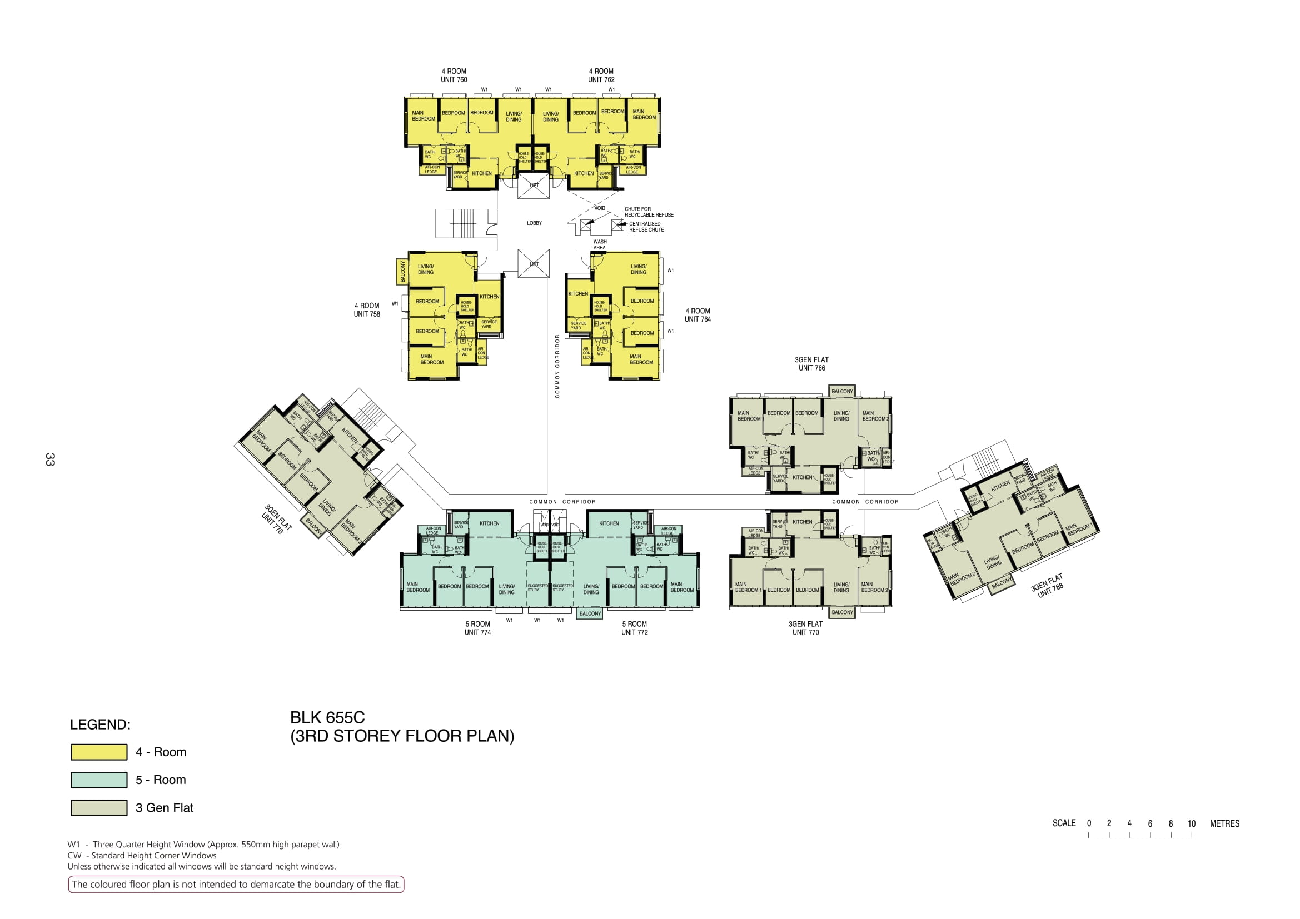

Slide 6


Slide 7


Slide 8


Slide 9
760
762
LOBBY
WASH AREA
758
764
COMMON CORRIDOR
766
776
COMMON CORRIDOR
COMMON CORRIDOR
768
774
772
770

Slide 10
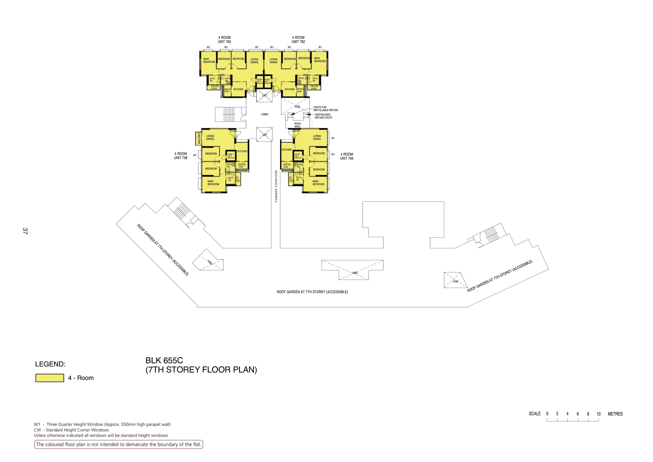

Slide 11
760
762
LOBBY
WASH AREA
758
764
COMMON CORRIDOR
ROOF GARDEN
ROOF GARDEN
ROOF GARDEN

Slide 12
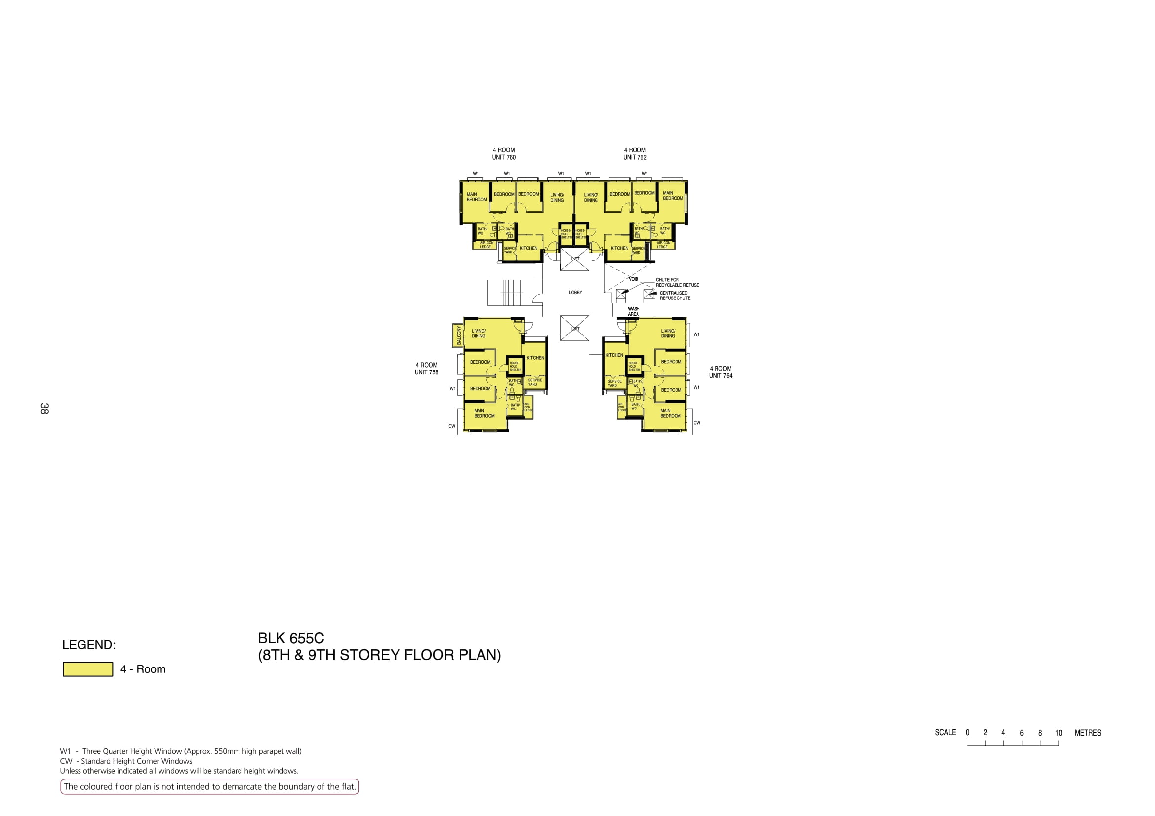

Slide 13
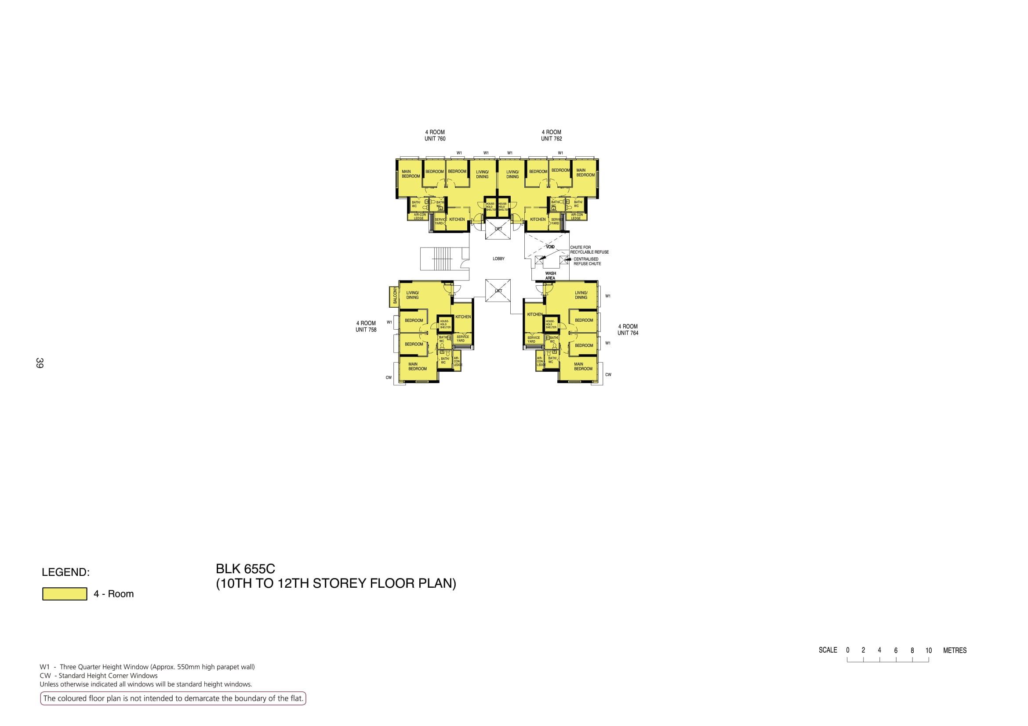

Slide 15
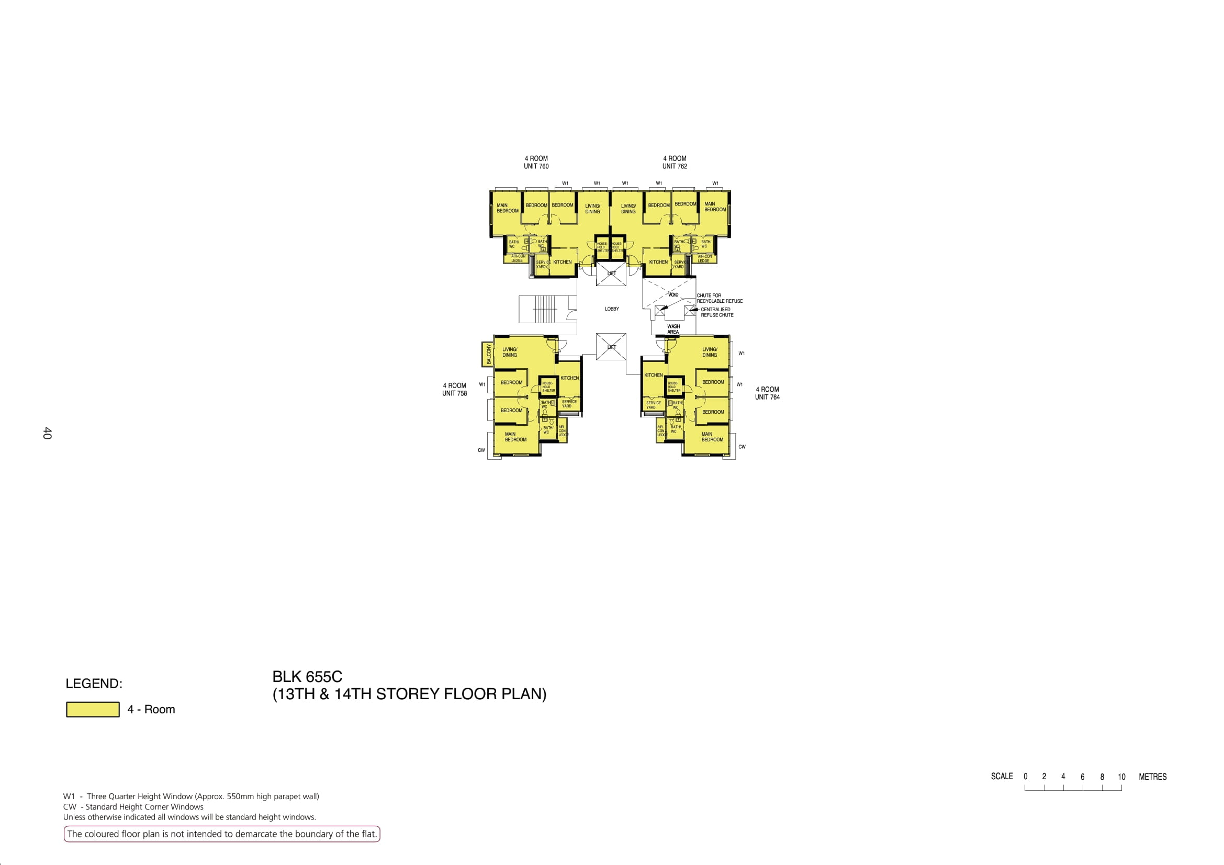

Slide 16
760
762
LOBBY
WASH AREA
758
764

